Slide 1


Slide 2

Notes:
LIZ FINKELMAN: Good morning, and welcome to this public webinar on Helping Patients in Addiction Treatment Stay Connected During the COVID-19 Pandemic, which has been jointly organized by the National Academy of Medicine and the American Society of Addiction Medicine.
My name is Elizabeth Finkelman and I direct the National Academy of Medicine’s Action Collaborative on Countering the U.S. Opioid Epidemic, which I will describe further in a minute. The Action Collaborative has benefitted greatly from the participation and leadership of the American Society of Addiction Medicine, represented by Dr. Kelly Clark, who I will introduce shortly, and we are so pleased to be collaborating on this webinar together.
Today’s free 90-minute webinar will provide insights on issues of access to addiction treatment and targeted guidance on how to effectively keep patients connected to treatment during the COVID-19 pandemic. This webinar has been approved for 1.5 hours of AMA PRA Category 1 credits and for 1.5 Continuing Education Credits from NAADAC, the Association for Addiction Professionals. Please note that in order to claim credit and receive the certificate of completion, participants will need to complete the mandatory evaluation at the completion of the webinar
The webinar will be recorded, and the video along with presenter slides will be posted on the NAM and ASAM websites after the event concludes.
This webinar is the first in a series called “Supporting People With Addiction During COVID-19”, hosted by the National Academy of Medicine and the American Society for Addiction Medicine. Future webinars in this series will be announced soon.

Slide 3

Webinar Agenda
11:00-11:10am Welcome and opening remarks
11:10-11:55am Panel presentations
11:55-12:25pm Moderated discussion and audience Q&A
12:25-12:30pm Closing remarks
12:30pm Webinar concludes
Notes:
LIZ FINKELMAN: Today’s webinar will last 90 minutes and will follow the agenda you see on your screens:
We will begin with 10 minutes of introductory remarks provided by myself and Dr. Kelly Clark, who is the immediate past president of ASAM, and will be moderating today’s discussion.
We will then hear from our panel of speakers, who will each speak for 15 minutes
We will then move into moderated discussion with the panel before opening it up to questions from the webinar audience.
The webinar will conclude by 12:30pm ET.

Slide 4
Questions from the Audience
Questions are welcome throughout the webinar and will be addressed at the end of the presentation.
Please use the comment box on your screen to enter a question.
Notes:
LIZ FINKELMAN: Questions and comments from the webinar audience can be submitted at any point during the webinar, and we will do our best to get to as many of them as we can before the webinar concludes. Please use the comment box on your screen to submit a question.
You can submit questions via the Q&A box located along the bottom of your screen. Simply type your question in the box at any time, and click “send.”
This webinar is being recorded. Please understand that any questions you submit may be read aloud and included in our recording.

Slide 5

Join the Conversation
Tweet with us
@theNAMedicine
@asamorg
#COVID19SUDTreatment
#OpioidCollaborative
Notes:
LIZ FINKELMAN: We hope you will join the conversation on social media and tweet over the course of the webinar by using the (hashtags): COVID19SUDTreatment and OpioidCollaborative.

Slide 6
Overview of the
NAM Action Collaborative on Countering the U.S. Opioid Epidemic
Elizabeth Finkelman, MPP
Director, Action Collaborative on Countering the U.S. Opioid Epidemic
Notes:
LIZ FINKELMAN: Now, I am going to spend just a couple minutes providing an overview of the NAM’s Action Collaborative on Countering the U.S. Opioid Epidemic.

Slide 7

The Action Collaborative is a public-private partnership of over 60 members from the public, private, and non-profit sectors.
Mission: To convene and catalyze public, private, and non-profit stakeholders to develop, curate, and disseminate multi-sector solutions designed to reduce opioid misuse, and improve outcomes for individuals, families, and communities affected by the opioid crisis.
Goals:
Identify and raise the visibility of complex challenges, outstanding research gaps and needs of the opioid crisis that require a collective, multi-sectoral response.
Elevate and accelerate evidence-based, multi-sectoral, and interprofessional solutions to improve outcomes for those affected by the opioid crisis.
Catalyze action on shared priorities and solutions to help overcome the crisis and improve outcomes for all.
Leadership: Steering Committee co-chaired by NAM, Aspen Institute, HHS, HCA Healthcare
Four priority focus areas (working groups): Health professional education and training; Pain management guidelines and evidence standards; Prevention, treatment, and recovery services; and Research, data, and metrics needs
Notes:
LIZ FINKELMAN:
Recognizing the need for a cohesive and collaborative response to the nation’s opioid epidemic, the National Academy of Medicine (NAM), established the Action Collaborative on Countering the U.S. Opioid Epidemic in 2018 as a public-private partnership to foster greater coordination and collective action across the health system and beyond in addressing the opioid addiction crisis. The Action Collaborative uses a systems approach to convene and catalyze public, private, and non-profit stakeholders to develop, curate, and disseminate multi-sector solutions designed to reduce opioid misuse, and improve outcomes for individuals, families, and communities affected by the opioid crisis.
The Action Collaborative embeds three foundational goals that guide its work:
The first is to identify and raise the visibility of complex challenges, outstanding research gaps and needs of the opioid crisis that require a collective, multi-sectoral response.
The second is to elevate and accelerate evidence-based, multi-sectoral, and interprofessional solutions to improve outcomes for those affected by the opioid crisis.
And lastly, the Action Collaborative aims to catalyze action on shared priorities and solutions to help overcome the crisis and improve outcomes for all.
The Action Collaborative’s work is organized around four core priority areas, which represent among the highest-priority elements of the nation’s response to the opioid crisis. These include:
Strengthening health professional education and training around SUDs and pain management;
Improving pain management guidelines and evidence standards;
Accelerating, sustaining and scaling, prevention, treatment and recovery services, and
Elevating pressing research, data, and metrics needs.
Around these areas we are producing several policy and technical white papers, as well as webinars, public meetings, and other dissemination activities.

Slide 8
Action Collaborative COVID-19 Response
Resource page on the Action Collaborative website to collate and share emerging COVID-19 resources across the Action Collaborative’s membership
Virtual town hall(s) for Action Collaborative members to share updates on ongoing efforts to address the impacts of COVID-19 on the OUD/SUD and pain populations. Also a platform to discuss challenges, opportunities, and lessons learned during this crisis.
Statement from the Action Collaborative Steering Committee highlighting critical priorities and actions that need to be taken in the immediate or very near term to protect the health and well-being of individuals with SUDs and pain in the context of the COVID-19 pandemic
Rapid response research agenda highlighting the most pressing and immediate research priorities and needs
Webinars on high priority topics to be produced in collaboration with Action Collaborative members and their organizations
Op-eds, publications covering priority topics and issues
Notes:
LIZ FINKELMAN:
Of course, with the emergence of the global COVID-19 pandemic earlier this year, the Action Collaborative is pivoting to focus on ways in which we can support the SUD and pain communities during this challenging time.
As such, we are undertaking a series of activities to be responsive in the near and longer term.
We have created a resources page on the Action Collaborative website to collate and share emerging COVID-19 resources across the Action Collaborative’s membership
We are conducting virtual town halls for Action Collaborative members to share updates on ongoing efforts to address the impacts of COVID-19 on the OUD/SUD and pain populations.
In the coming weeks, our steering committee of cross-sectoral leaders will be releasing a statement highlighting critical priorities and actions that need to be taken in the immediate or very near term to protect the health and well-being of individuals with SUDs and pain in the context of the COVID-19 pandemic
We will also be highlighting pressing and immediate research priorities and needs
And of course, producing publications and conducting webinars, such as these, on high priority topics.
I have only scratched the surface of our activities and efforts, so I encourage the viewers to visit the Action Collaborative’s website to learn more and to sign-up for updates.

Slide 9
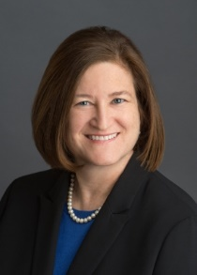
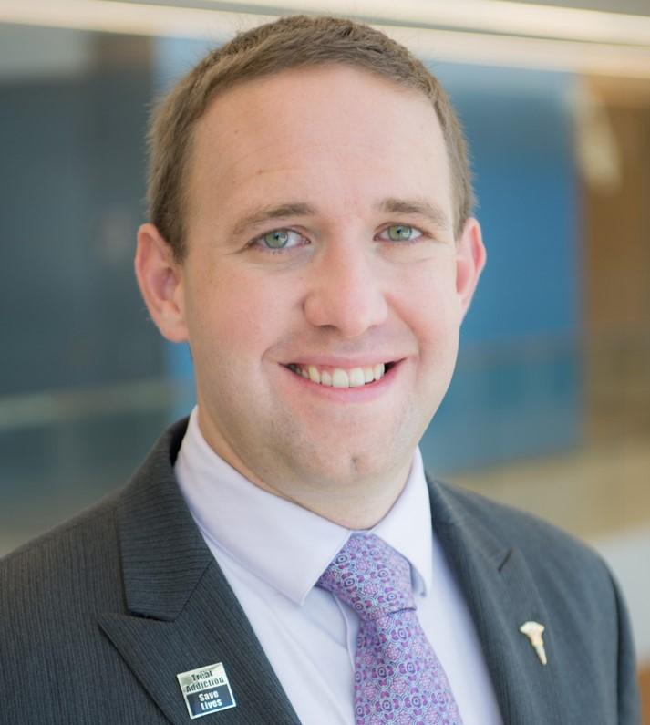
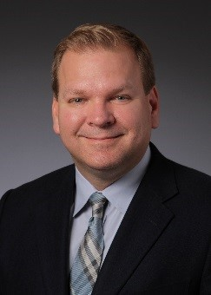

Webinar Speakers
Kelly J. Clark, MD, MBA, Immediate Past President, American Society of Addiction Medicine
Brian Hurley, MD, MBA, Director of Addiction Medicine for the Los Angeles County Department of Health Services
Chris Bundy, MD, MPH,
Executive Medical Director, Washington Physicians Health Program
Cortney Lovell, CRPA, CARC, RCP,
Recovery Coach, and Co-Founder, Our Wellness Collective
Notes:
LIZ FINKELMAN: Now, I am pleased to introduce this terrific and talented group of experts, whom you will have the pleasure of hearing from today.
Today’s discussion will be moderated by Dr. Kelly Clark, who is the Immediate Past President of the American Society of Addiction Medicine.
Joining Dr. Clark are:
Dr. Brian Hurley, who is the Director of Addiction Medicine at the Los Angeles County Department of Health Services;
Dr. Chris Bundy, who is the Executive Medical Director of the Washington Physicians Health Program; and
Ms. Cortney Lovell, who is a recovery coach and Co-Founder of Our Wellness Collective.
Viewers can download and read their impressive biographies on the webinar event page to learn more.
And with that, let me turn the presentation over to Dr. Clark.

Slide 10
Overview of the
American Society of Addiction Medicine’s COVID-19 Response and Today’s Webinar
Kelly J. Clark, MD, MBA, DFAPA, DFASAM

Slide 11
Learning Objectives
At the end of this webinar, you will be able to:
Discuss unique challenges to substance use treatment providers and patients during the COVID-19 pandemic.
Recognize patient-centered strategies for maintaining access to addiction treatment
Identify recent changes to telehealth regulations, payment, and clinical guidance related to access to medications and support groups.
Describe strategies to ensure patients remain connected with their providers, treatment and recovery plans during the COVID-19 pandemic.

Slide 12
ASAM is working to rapidly develop consolidated resources to support addiction treatment providers in addressing the COVID-19 crisis:
Guidance from Federal agencies and national
stakeholder groups
CPDC Task Force Guidance
Coordinating with members through state chapters to provide support in addressing state level issues
https://www.asam.org/Quality-Science/covid-19-coronavirus

Slide 13
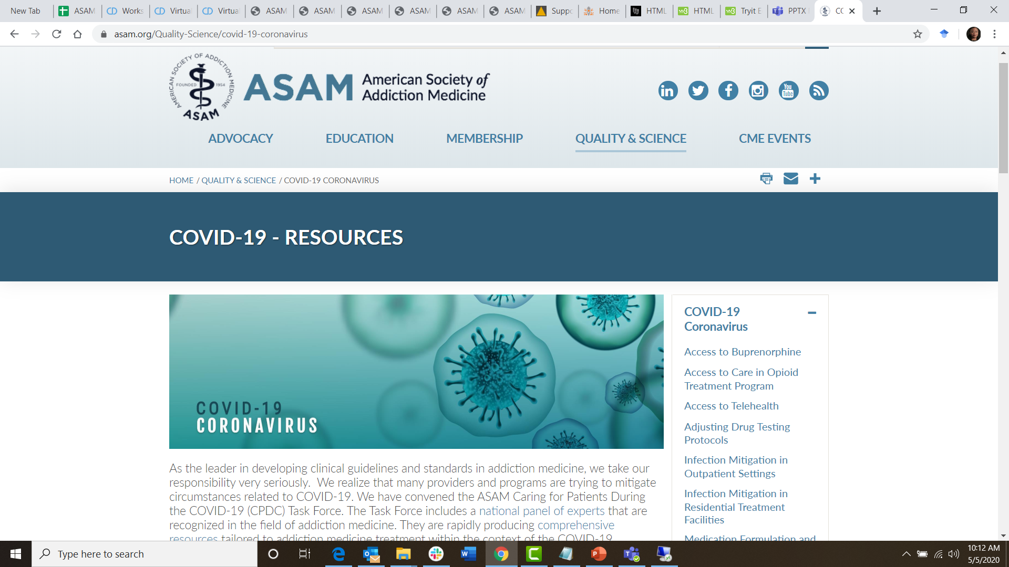

Slide 14
CPDC Task Force Guidance Topics
Published Guidance:
Infection Mitigation: Outpatient Settings
Infection Mitigation: Residential Settings
Telehealth Guidance
Adjusting Drug Testing Protocols
Access to Buprenorphine in Office-Based Settings
Access to Care in Opioid Treatment Programs
Support Group Guidance
Guidance on Medications, Dosages and Formulations
Treating Pregnant Women with OUD

Slide 15
CPDC Task Force Guidance Topics
Guidance Coming Soon:
Guidance for General Hospitals
Criminal Justice
Homeless Populations
Clinician and Physician Well-being

Slide 16
Important Differences
Guidance
Guidelines
A relatively rapid process where content is:
developed by a few experts
vetted by a review group
quickly released to address a pressing crisis.
A slower process (a year or more) that includes:
the development of a rigorous methodology
a final stage of public comments and the approval of the Board of Directors.
VS

Slide 17

Three Underlying Themes
1. Clinicians, treatment programs, and systems of care must pivot during times of disaster from traditional 'best practices' which rely upon usual resource availability, while providing the best care possible under their circumstances for the patients in their community.

Slide 18

Three Underlying Themes Cont’d
2. Rapid and deep federal guidance, regulatory changes, and payment changes must be implemented within state and local regulatory and payment structures.
3. There is an urgent/emergent need for clinicians, treatment programs, systems of care to break from silos and collaborate for new systems

Slide 19
Anticipated Phases of the COVID-19 Pandemic
Post- Pandemic
Early Phase
Middle Phase
Low population prevalence
Preventing transmission of the virus using physical distancing
Develop protocols for keeping infectious patients /staff in isolation or quarantine
PLAN FOR PHASE 2 !
Higher population prevalence makes isolating of individuals impractical
Designating entire areas/systems, including community housing, as available to either infectious or non-infectious persons.
Updated best practices are implemented based upon lessons learned

Slide 20

COVID-19 Resources
We want to hear from the field.
If you have protocols or approaches you would like to share widely, or
If you have questions or concerns related to the guidance:
  Email COVID@asam.org

Slide 21
Supporting Patient Access to Treatment
Brian Hurley, MD, MBA, DFASAM

Slide 22

Addiction During COVID-19
The COVID-19 pandemic may increase the demand for addiction treatment:
COVID-19
Stress, anxiety and isolation
“Stay-at-Home” orders and border restrictions
Unemployment, loss of economic opportunity, and poverty
Negative Outcomes
Increase symptoms of addiction and mental illness
Reduce drug availability
Increase symptoms of addiction and mental illness
It is critical that patients have access to treatment during this public health emergency.

Slide 23



Bridging the Gap with Telehealth
Continue patient engagement while minimizing in-person interactions
Telemedicine or telephonic visits used whenever possible and clinically appropriate
  Forgo routine in-person toxicology testing when clinically appropriate
  Increase utilization of remote toxicology testing as feasible
Assess whether the risk of conducting in-person examination is worth the benefit via a changed treatment plan

Slide 24
ASAM Telehealth Guidance: Key Topics
Changes to federal policies related to telehealth during this public health emergency
Variable and Evolving Changes to State Policies and Regulations
  Medicaid
  Licensing
What to Consider When Implementing Telehealth
  Technology considerations
  Communicating with patients
  Documentation
  Workflow
Links to valuable resources from other organizations (AMA, APA, National Council) that are updated as new or revised policies/regulations are released
www.asam.org/Quality-Science/covid-19-coronavirus/access-to-telehealth
Notes:
www.asam.org/Quality-Science/covid-19-coronavirus/access-to-telehealth

Slide 25
Telehealth Platforms
 | Visit | Consult
Synchronous | Virtual Audio-Visual Visit between patient and provider | Virtual Audio-Visual Visit between provider and consultant
Asynchronous | eVisit – online exchange between patient and provider | eConsult – online exchange between provider and consultant
Telephone | Can be synchronous (live) or asynchronous (voicemail exchange) without a visual component; not traditionally considered to be ‘Telehealth’ and is instead referred in regs as ‘telephone’ or ‘telephonic’
Advisable to update malpractice carrier to discuss telehealth coverage

Slide 26
COVID-19 Telehealth Rules
1135 Waiver authorizes providers to offer telehealth services in any healthcare facility
MediCare: http://www.cms.gov/newsroom/fact-sheets/medicare-telemedicine-health-care-provider-fact-sheet
HHS Privacy Rules: http://www.hhs.gov/hipaa/for-professionals/special-topics/emergency-preparedness/notification-enforcement-discretion-telehealth/index.html

Slide 27
COVID-19 Telehealth Rules
Can issue controlled substance Rx to patients for whom we have not previously conducted an in-person medical evaluation
  Buprenorphine is specifically permitted to be initiated following synchronous telephone call (does not require visual telehealth component)
MediCare: http://www.cms.gov/newsroom/fact-sheets/medicare-telemedicine-health-care-provider-fact-sheet
HHS Privacy Rules: http://www.hhs.gov/hipaa/for-professionals/special-topics/emergency-preparedness/notification-enforcement-discretion-telehealth/index.html

Slide 28
COVID-19 Telehealth Rules
Enforcement of HIPAA Rules have been relaxed to support telehealth services through remote communications technologies, including technologies not fully compliant with the requirements of the HIPAA Rules
MediCare: http://www.cms.gov/newsroom/fact-sheets/medicare-telemedicine-health-care-provider-fact-sheet
HHS Privacy Rules: http://www.hhs.gov/hipaa/for-professionals/special-topics/emergency-preparedness/notification-enforcement-discretion-telehealth/index.html

Slide 29

Specific Telehealth Platforms
Not an exhaustive list nor an endorsement of any of the below:
HIPAA Compliant Options (often through BAA):
Zoom
Skype
Microsoft Teams
Cisco Webex Meetings
GoToMeeting
BlueJeans
VSee
doxy.me
Allowable, Non-HIPAA Compliant Options:
Apple FaceTime
Facebook Messenger video chat
Google Hangouts video

Slide 30

Specific Telehealth Platforms
Not an exhaustive list nor an endorsement of any of the below:
Not allowed:
Instagram Live
Facebook Live
Twitch
TikTok
and their equivalents

Slide 31
Practical Tele-Session Approach
Factor in the patient’s ability and familiarity with technology platform
Confirm patient’s identity and location
Obtain phone number to reach patient in case of technology/ communication failure
Obtain patient’s consent to participate in telehealth
Arrange for any medically necessary monitoring and follow-up
The standard of care is the same whether treatment is rendered in person or via telemedicine. Services are deemed rendered where the patient is located, not where the provider is.

Slide 32
Access to Opioid Treatment Programs:
Key Points
Reimbursement Issues​
Considerations for Documentation​
Staffing Challenges​
Medication Supply Issues​
Waiting Room Precautions​
​
Importance of Remaining Open and Available
Clinical considerations related to
    Take home doses
    Medication selection
    In-person visits
Managing telehealth visits
Federal Regulatory Changes
www.asam.org/Quality-Science/covid-19-coronavirus/access-to-care-in-opioid-treatment-program
Notes:
www.asam.org/Quality-Science/covid-19-coronavirus/access-to-care-in-opioid-treatment-program

Slide 33
Access to Buprenorphine: Key Points
Leveraging Telehealth
Prescriptions and Refills
Psychosocial Treatment
Ensuring Adequate Buprenorphine Supply
Harm Reduction, including Naloxone Distribution
Considerations for High Risk Patients
Notes:
https://www.asam.org/Quality-Science/covid-19-coronavirus/access-to-buprenorphine

Slide 34
Medication, Dosage, and Formulation
Guidance: Key Points
Medication Selection
Formulations and Dosages of Buprenorphine
Dosages and Take-Home Doses of Methadone
Formulations and Dosages of Naltrexone
Alcohol Withdrawal Management
Dosages and Formulations of Nicotine Cessation Medications
www.asam.org/Quality-Science/covid-19-coronavirus/medication-formulation-and-dosage-guidance
Notes:
https://www.asam.org/Quality-Science/covid-19-coronavirus/access-to-buprenorphine

Slide 35

Policy Changes on Access to Addiction Treatment
Federal Policy Changes to Date
Waiver of regulatory requirements related to HIPPA compliant telehealth platforms (OCR)
Expansion of Medicare Coverage for Providing Services through Telehealth (CMS)
Flexibility for Take Home Medication for OTPs (SAMHSA)
Flexibility for Prescribing Controlled Substances via Telehealth (SAMHSA/DEA)
Exception to Separate Registration Requirements Across State Lines (DEA)
Compliance with Addiction Treatment Confidentiality Regulations – 42 CFR Part 2 (SAMHSA)

Slide 36

Weighing and
Managing Risks
Implementing Guidance on the Ground
Providers are dealing with situations they are not comfortable with, balancing difficult choices against each other with very little evidence to guide them​
Stability and Safety​
Prescribing and Dosing​
Testing​
Diversion ​

Slide 37
Implementing Telehealth Program
COVID-19 Adjustments in Los Angeles County Department of
Health Services
Rapid deployment of expected practice guidance
On-Call telephone consultation
Capacitize field and hotel quarantine / isolation sites for people experiencing homelessness
Moving routine services to tele-visits, and installation of a telehealth platform

Slide 38
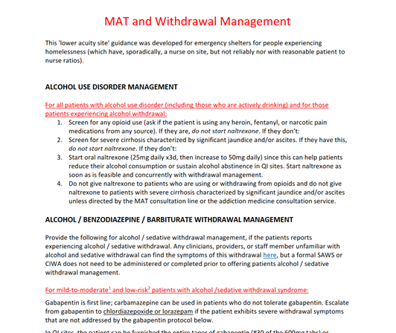
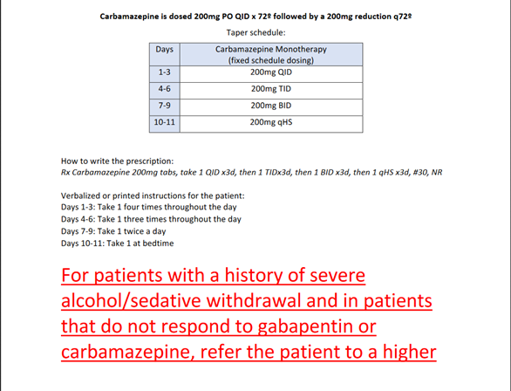
Example of Expected Practice
https://www.asam.org/Quality-Science/covid-19-coronavirus/medication-formulation-and-dosage-guidance

Slide 39
Supporting Patient Participation in Support Groups
Christopher Bundy, MD, MPH, FASAM

Slide 40
Recovery During COVID-19
Stress, anxiety and isolation related to the pandemic can compromise recovery
  Normal support systems are disrupted
  New unemployment and financial stress
  New/changing responsibilities for children who are no longer in school
  Uncertainty around how and when this will end
Social support and connectedness are critical for achieving and maintaining recovery.

Slide 41

Virtual Support Groups
In the absence of in-person recovery support groups providers should encourage participation in virtual groups​
  Consider proactive outreach ​
Online support groups are ubiquitous, most using Zoom​
Convenient/accessible/acceptable​
Varied: Not just 12-step​
Privacy/security measures effective and improving​
Enhances recovery support/engagement, decreasing isolation​
Silver linings: Sustainable adjunct to traditional in-person meetings, will likely continue post-COVID19
www.asam.org/Quality-Science/covid-19-coronavirus/support-group

Slide 42
Considerations for Small Group Meetings
Consider virtual meetings if possible (e.g. IOP groups)​
Follow applicable public health recommendations and orders​
  Not advised during periods of community spread with some exceptions (tx groups)​
  Limit meeting size to 10 or fewer participants​
  Screen for symptoms prior to entry​
  Sick or high-risk individuals should not attend​
  Respiratory hygiene (cover cough, hand-washing sanitizer, dispose of tissues)​
  6-foot rule, well-ventilated space, face-masks​
  Environmental sanitation​
  Avoid touching others ​
  Avoid shared food/beverages​
Consider collecting contact information in case of need for contact tracing

Slide 43
ASAM Support Group Guidance
See the ASAM COVID site for more on:
  Etiquette for online support groups​
  How to protect privacy and anonymity on Zoom meetings​
  Considerations for maintaining confidentiality
https://www.asam.org/Quality-Science/covid-19-coronavirus/support-group

Slide 44
Accessing Recovery Supports During the COVID-19 Pandemic
Cortney Lovell, Recovery Coach

Slide 45


Slide 46
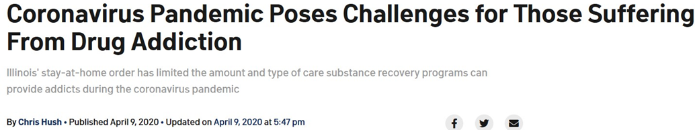
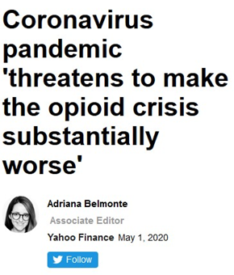
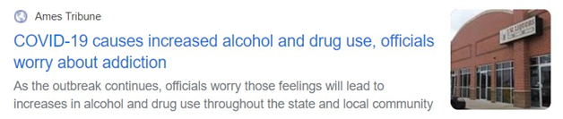
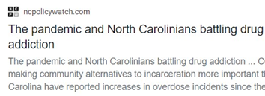

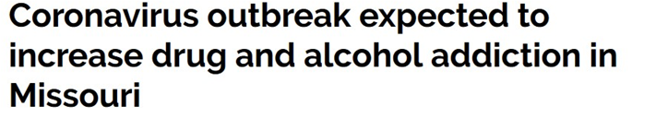

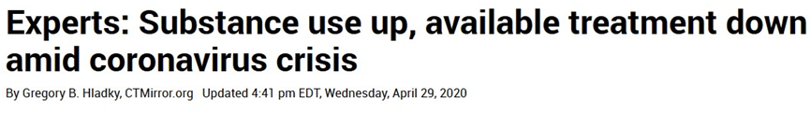

Slide 47
“We know very little right now about COVID-19 and even less about its intersection with substance use disorders. But we can make educated guesses based on past experience that people with compromised health due to smoking or vaping and people with opioid, methamphetamine, cannabis, and other substance use disorders could find themselves at increased risk of COVID-19 and its more serious complications—for multiple physiological and social/environmental reasons…”
Dr. Nora Volkow
National Institute on Drug Abuse Blog 4/6/20
https://www.drugabuse.gov/about-nida/noras-blog/2020/04/covid-19-potential-implications-individuals-substance-use-disorders

Slide 48
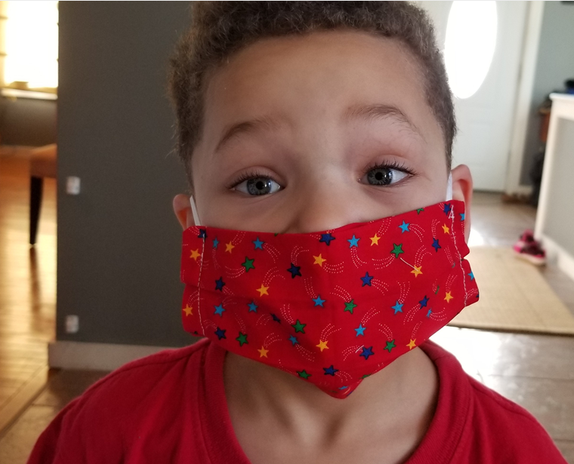
This is the dawning of
the age of Aquar–
… Harm Reduction

Slide 49
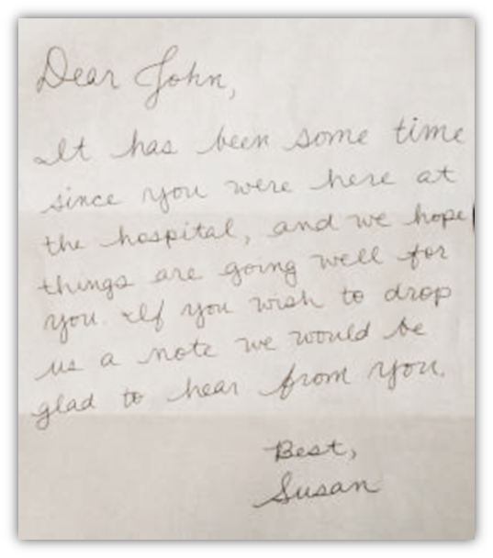
“Dear John,
It has been some time since you were here at the hospital, and we hope things are going well for you. If you wish to drop us a note we would be glad to hear from you.
Best,
Susan"
Motto, J. A., & Bostrom, A. G. (2001). A randomized controlled trial of postcrisis suicide prevention. Psychiatric Services, 52(6), 828-833

Slide 50
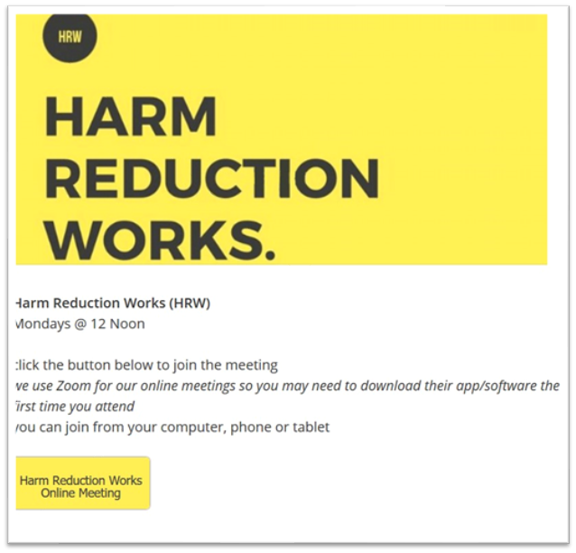

www.ourwellnesscollective.com

Slide 51

RESOURCES
www.RecoveryTraining.Online

Slide 52




Cortney@ourwellnesscollective.com
Thank you
@cortneylovell1
@lovellcortney
facebook.com/cortney.lovell

Slide 53
Panel Discussion
Kelly J. Clark, MD, MBA, Immediate Past President, American Society of Addiction Medicine
Brian Hurley, MD, MBA, Director of Addiction Medicine for the Los Angeles County Department of Health Services
Chris Bundy, MD, MPH,
Executive Medical Director, Washington Physicians Health Program
Cortney Lovell, CRPA, CARC, RCP,
Recovery Coach, and Co-Founder, Our Wellness Collective

Slide 54
Audience Q&A
Please use the comment box on your screen to enter a question.

Slide 55
Thank you for joining!
Webinar recordings, information on CE and more are available at:
nam.edu/TreatmentWebinars
Notes:
LIZ FINKELMAN: I’d like to conclude the webinar by extending our special thanks to ASAM and the webinar speakers, and to all the webinar attendees for participating.
This webinar has been recorded. You can find the webinar recording, speaker slides, as well as information on continuing education credits and more at nam.edu/TreatmentWebinars.
Thanks again for your participation. Please stay safe and well, and enjoy the rest of your day.

